Slide 1
Music Player
CS5551:Advanced Software Engineering
Presented By:
Vilas Mamidyala (25)
Dinesh Kumar Bandam (04)
Ranjitha Reddy BhumiReddy(05)

Slide 2




ARCHITECTURE
LOGIN
USER
STORAGE

Slide 3
Features
This is a music player application which has different songs suggestion and classification to the user.
User gets all the songs from the internal memory storage and SD card present in the smart phone.
Songs were classified as new songs which are currently in trend and old songs which are from the olden days.
Songs suggestion based on Time i.e with respective to morning, afternoon, evening and night.
Other classification is based on Moods and Genres.
Instrumental
Rock
Pop
Devotional
Classics
Party
Facebook Login

Slide 4
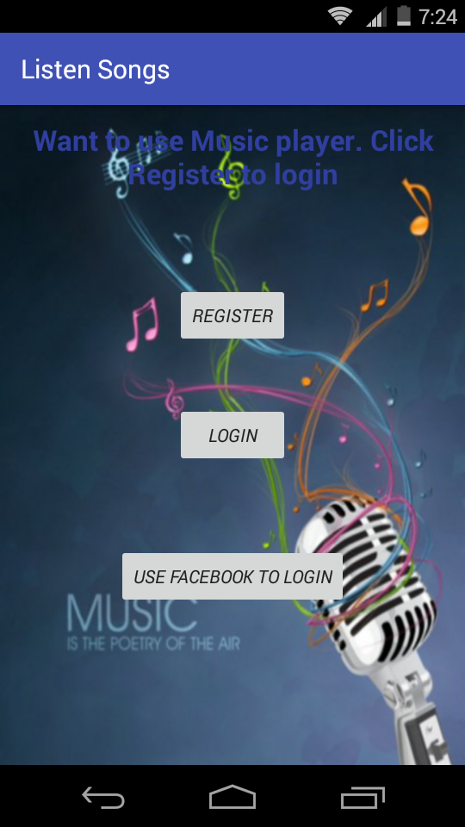
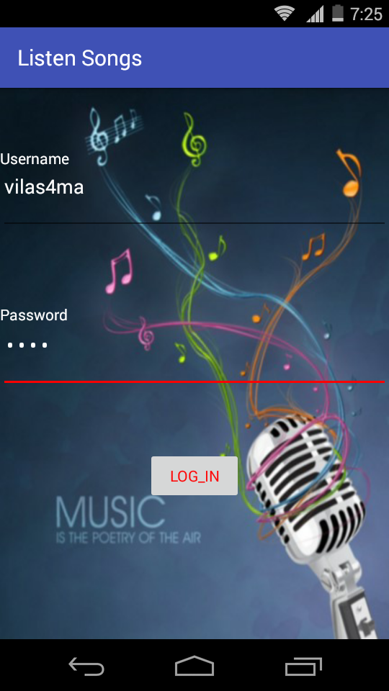
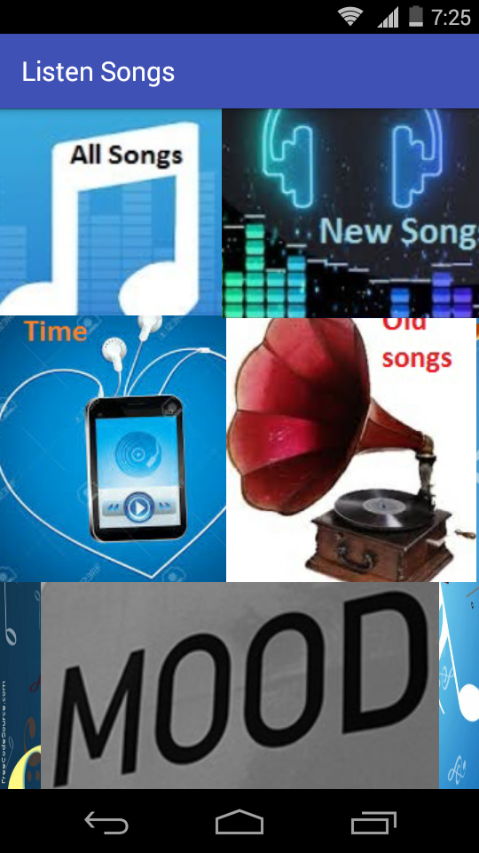
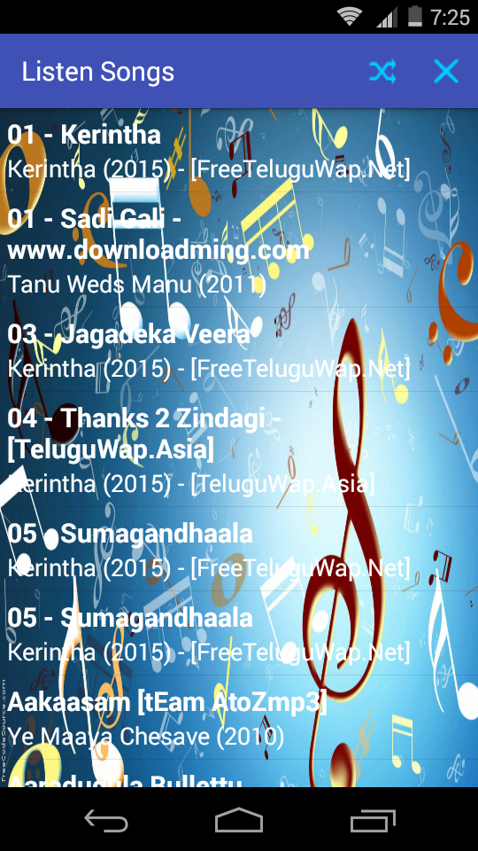
SCREEN SHOTS

Slide 5
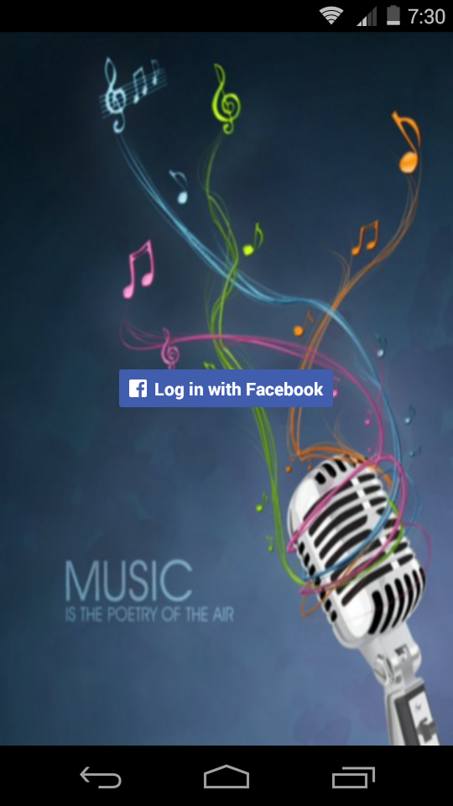
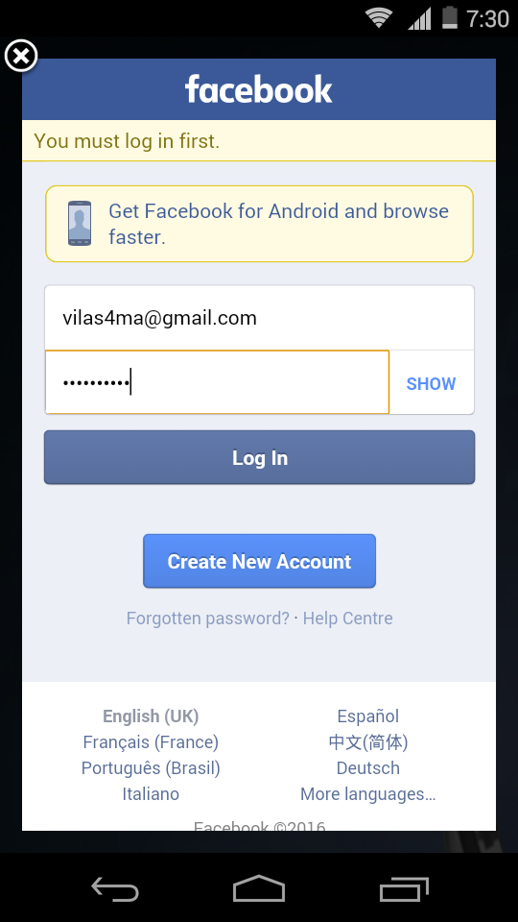
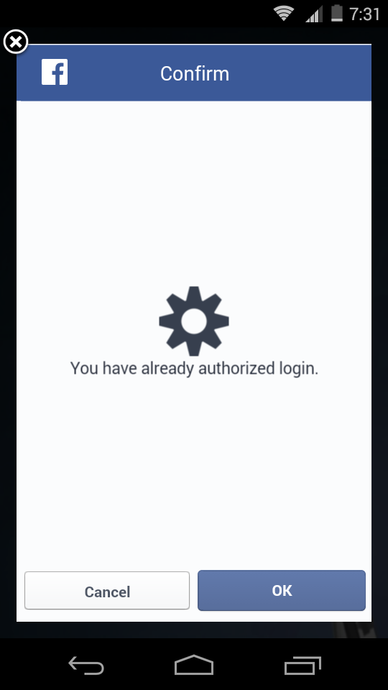
SCREEN SHOTS

Slide 6
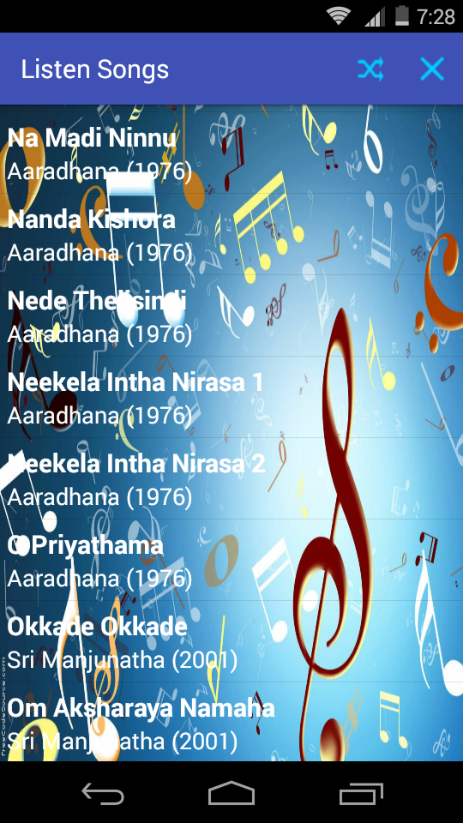
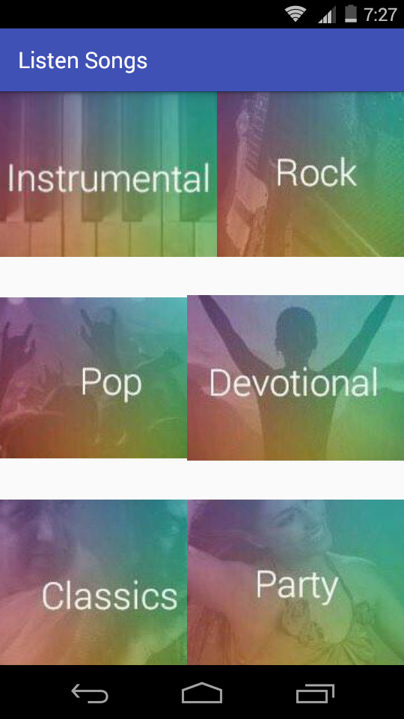
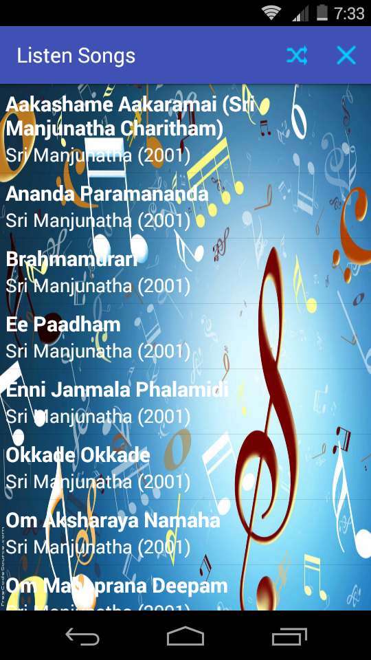
SCREEN SHOTS

Slide 7
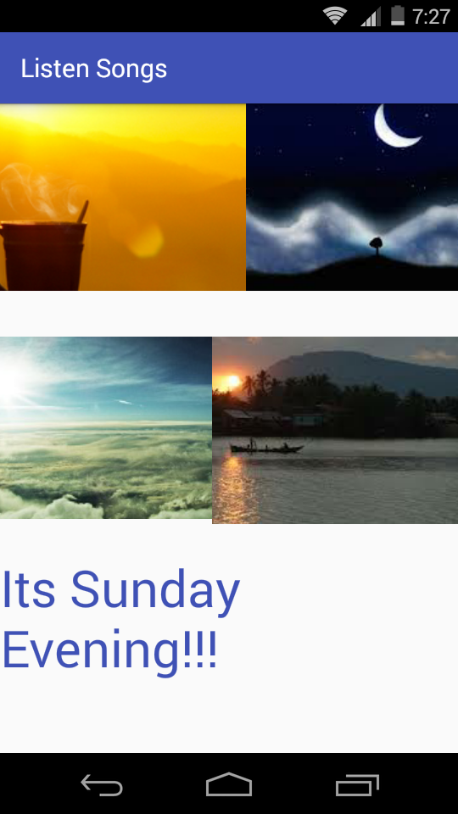
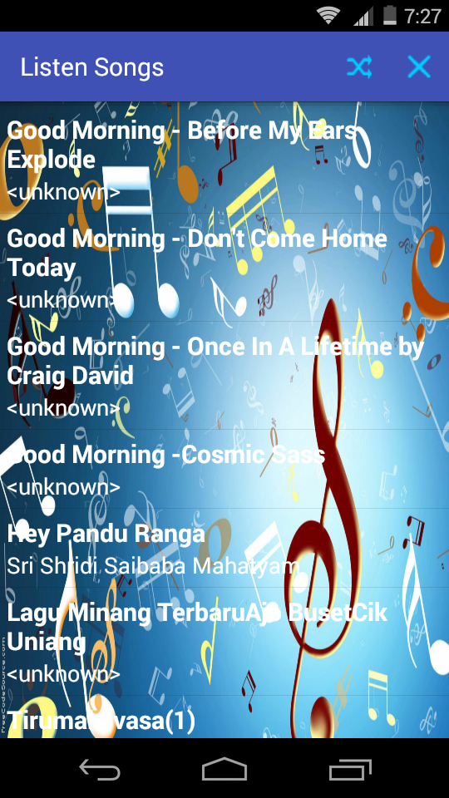
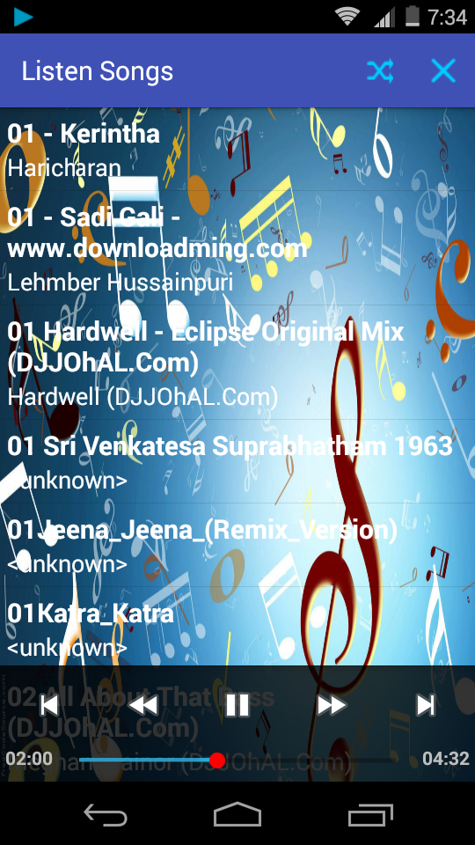
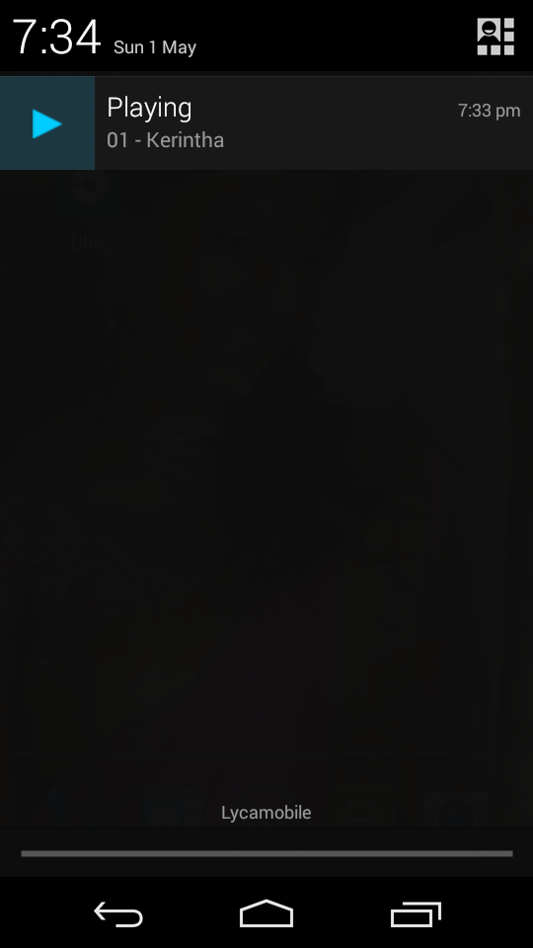
SCREEN SHOTS

Slide 8


